Slide 1
© Crown Copyright 2018

Slide 2
How to use this presentation
The purpose of this presentation is to provide your employees with an overview of mail screening and security to complement CPNI’s campaign, as well as other internal procedures.
© Crown Copyright 2018

Slide 3
AGENDA
Introduction to mail screening and security
Case studies
Suspicious indicators
Response guidance
© Crown Copyright 2018

Slide 4
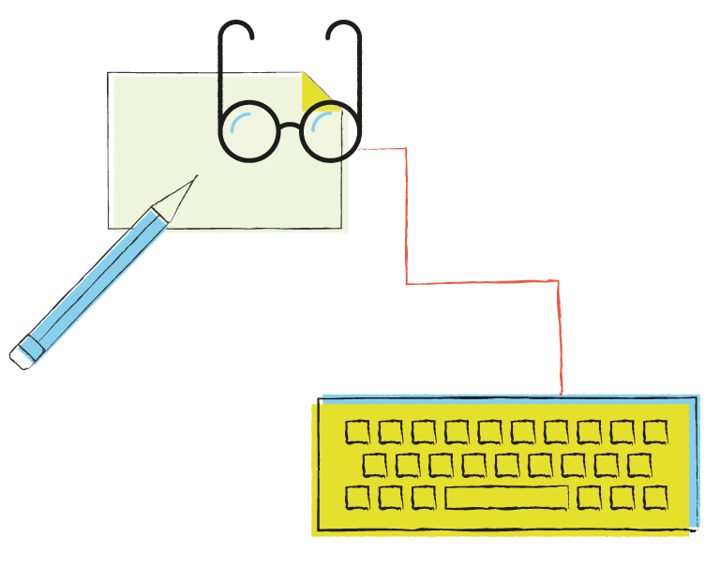
INTRODUCTION
Every day, our organisation receives and sends mail.
Would you know what to do if one item seemed suspicious?
© Crown Copyright 2018

Slide 5
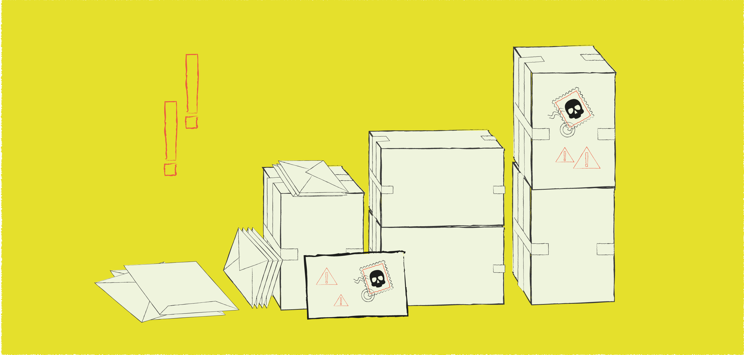
Many types of mail items are regularly delivered to our organisation – by courier, commercial mail services or by hand.
© Crown Copyright 2018

Slide 6
Mail streams into and within our organisation present opportunities for malicious attacks or hoaxes, and without the appropriate security measures, this can affect day-to-day operations, as well as our reputation.
© Crown Copyright 2018

Slide 7
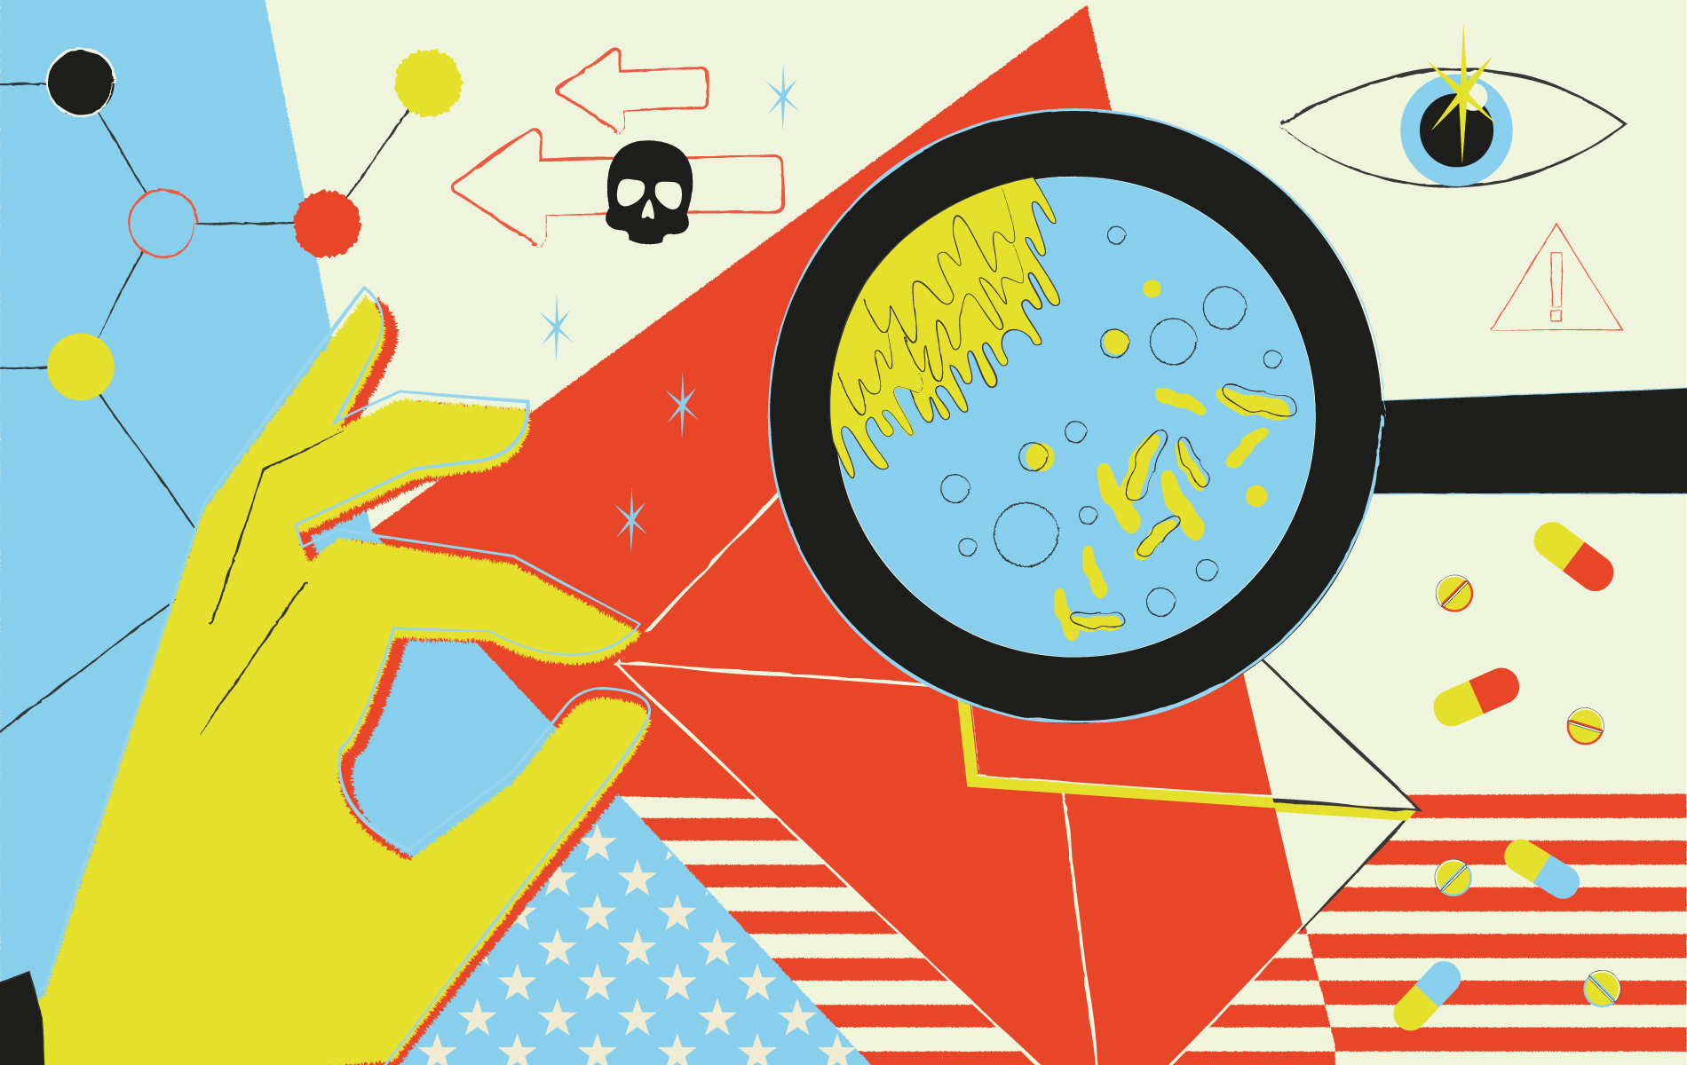
CASE STUDIES
2001 US anthrax letters
Anonymous mailings of anthrax in the US left several dead and many more affected after letters were sent to media companies and senators in 2001.
This could be considered a worst-case scenario for what can happen when suspicious packages delivered to an organisation’s site slip through the net.
As organisations are still at risk of receiving such mail, it’s a reminder that this is still a real threat.
© Crown Copyright 2018

Slide 8
CASE STUDIES
2011 UK hoax campaign
Six ‘anthrax’ letters addressed to parliamentary figures in 2011 were successfully intercepted at a mail screening centre in London.
They turned out to be a malicious hoax, but the centre's intervention is a great example of why it's important for organisations to implement a robust mail screening and security process.
© Crown Copyright 2018

Slide 9
Mail screening matters, and our organisation has measures in place because we are committed to keeping you safe.
© Crown Copyright 2018

Slide 10
But everyone has a part to play in minimising the risk and impact of suspicious mail.
© Crown Copyright 2018

Slide 11
Suspicious indicators
Spotting just one suspicious indicator on an item of mail could make all the difference.
© Crown Copyright 2018

Slide 12
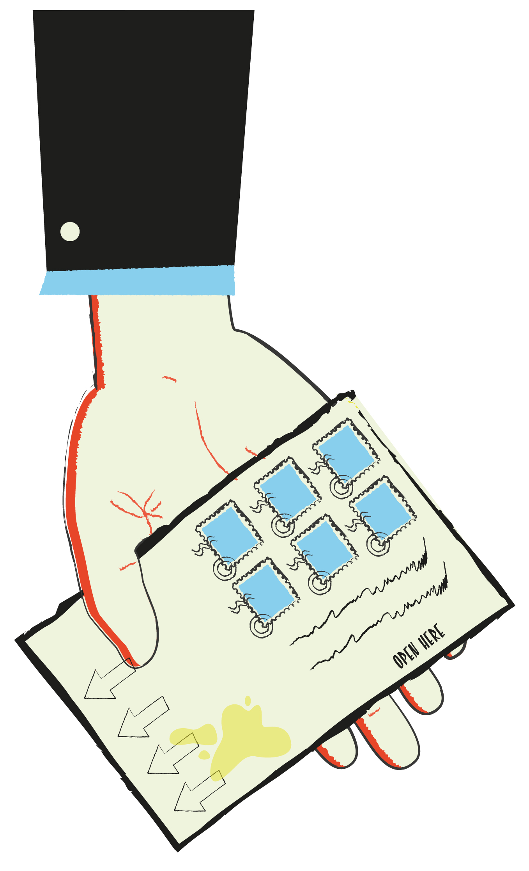
SUSPICIOUS INDICATORS
To know if an item of mail is suspicious,
be aware of the following indicators:
Is the weight of the item unevenly distributed?
Are there any greasy or oily stains?
Is the recipient encouraged to open the package in a particular way?
Is the handwriting unfamiliar?
Are there more stamps than strictly necessary?
© Crown Copyright 2018

Slide 13
HOW TO RESPOND IF YOU DISCOVER A SUSPICIOUS DELIVERY
Avoid.
Don't touch the item
Avert.
Move away immediately
Alert.
Contact security at XXXX
© Crown Copyright 2018

Slide 14
Conclusion
By understanding the importance of mail security and how to recognise and respond to an unexpected situation,
you can help safeguard our organisation from a postal threat.
For more information, contact [security personnel] or search for mail screening at www.cpni.gov.uk
© Crown Copyright 2018

